Slide 1
Chapter 10
File Systems
1

Slide 2
Chapter 4.1: File System
What is a file system
Objectives and user requirements
Characteristics of files and directories
File system implementation
Directory implementation
Free block management
File system reliability
Increasing file system performance

Slide 3
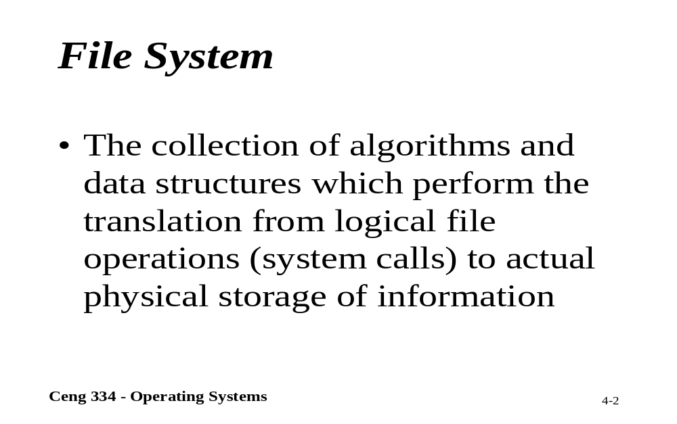
File System

Slide 4
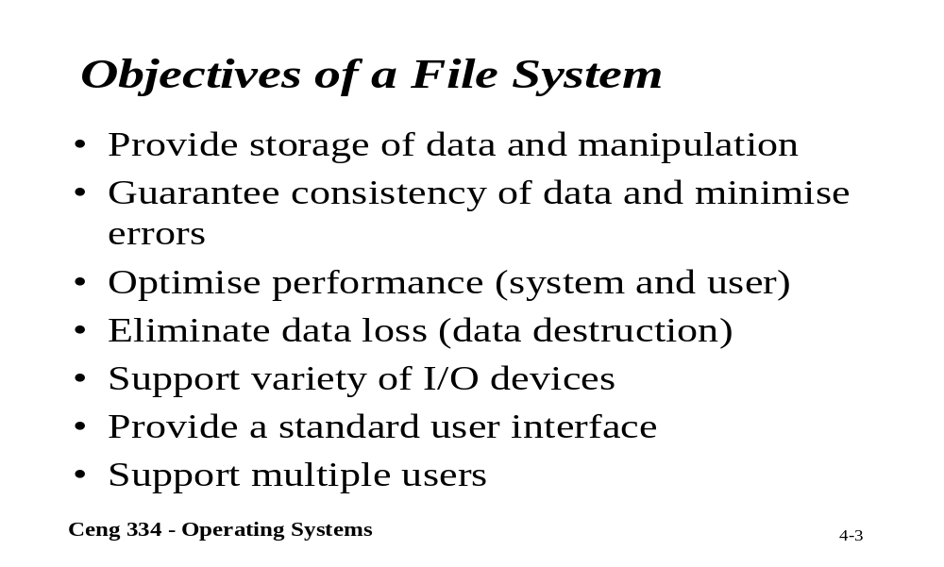
Objectives of a File System

Slide 5
Long-term Information Storage
Must store large amounts of data
Information stored must survive the termination of the process using it
Multiple processes must be able to access the information concurrently

Slide 6
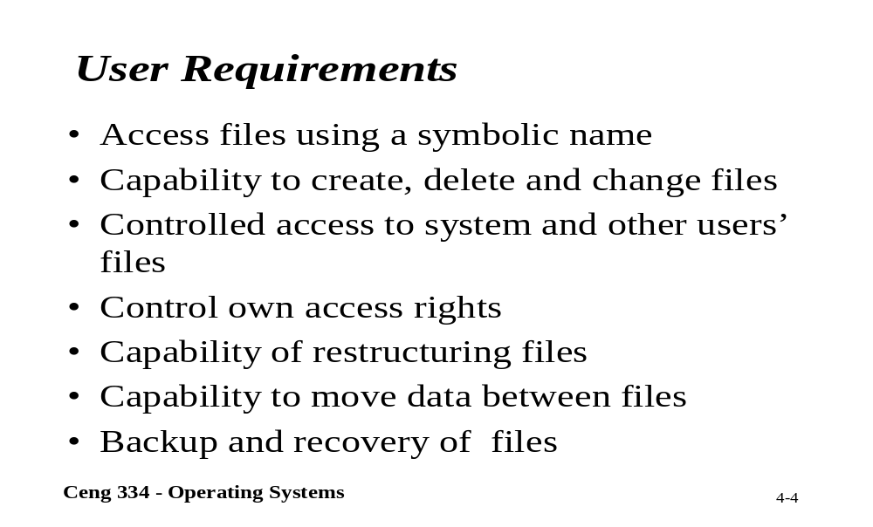
User Requirements

Slide 7
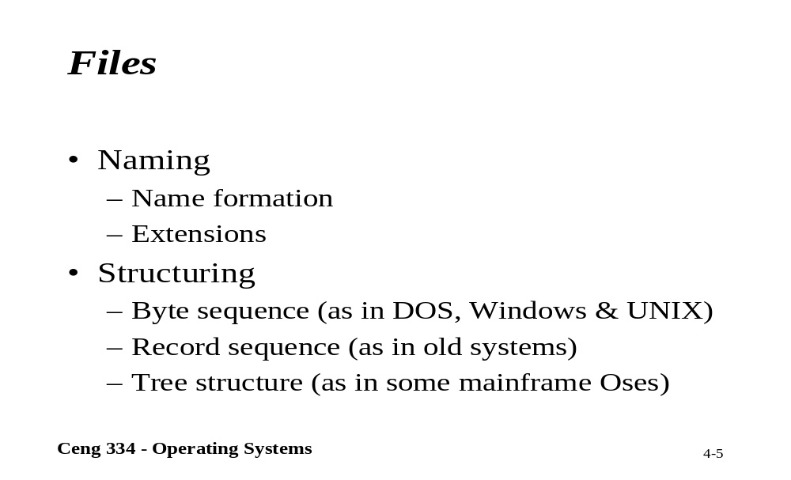
Files

Slide 8
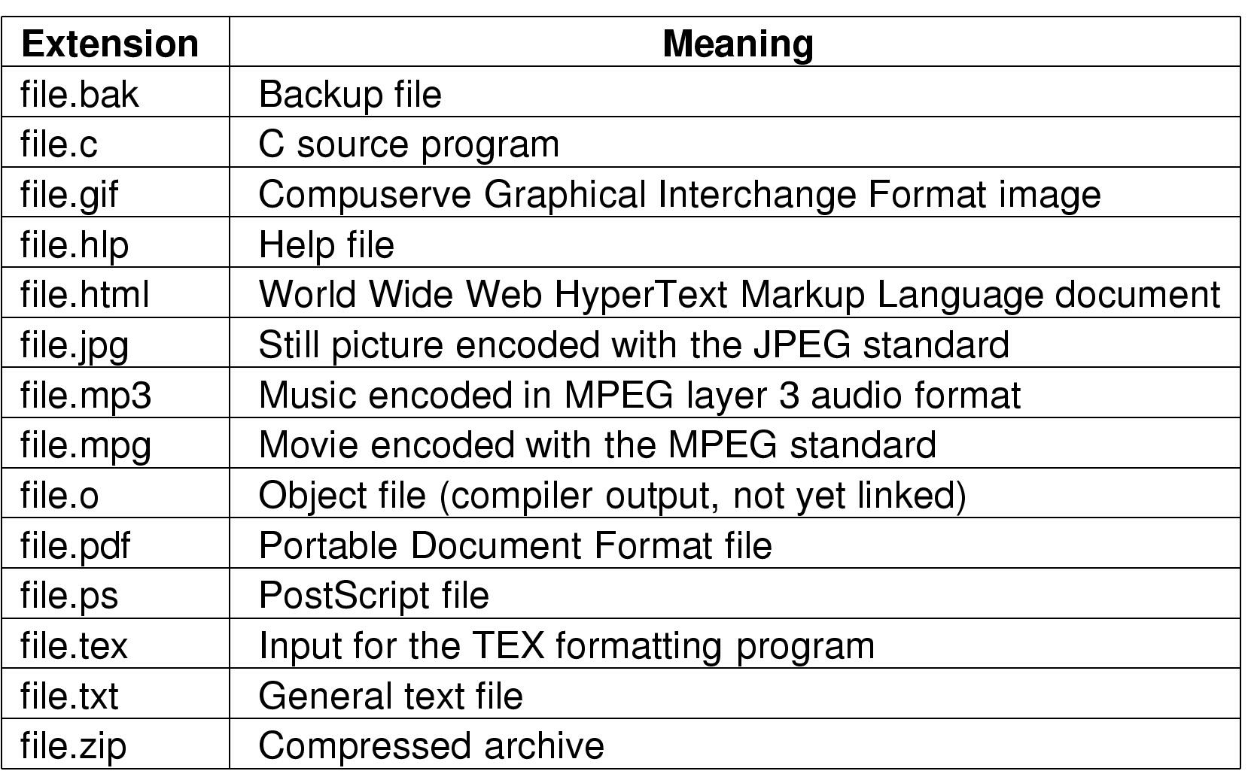
File Naming
Typical file extensions.

Slide 9
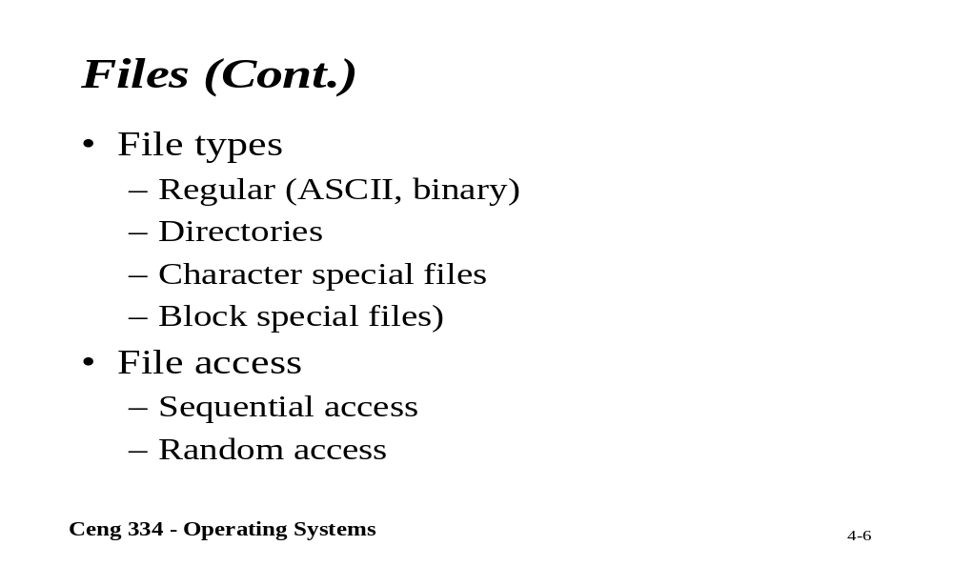
Files

Slide 10
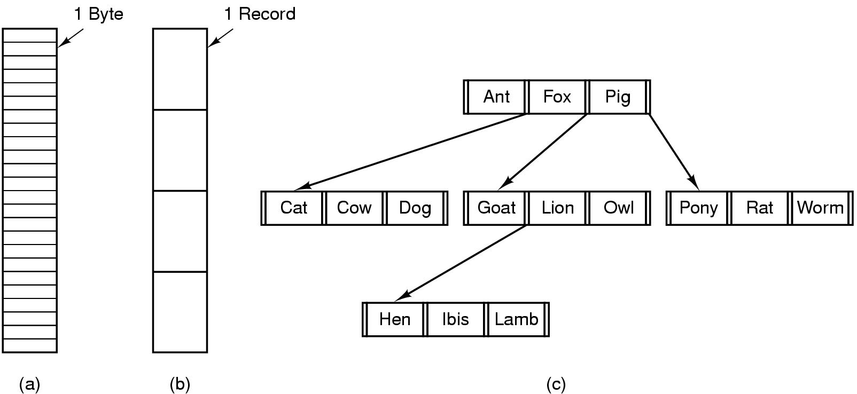
File Structure
Three kinds of files
  byte sequence
  record sequence
  tree

Slide 11
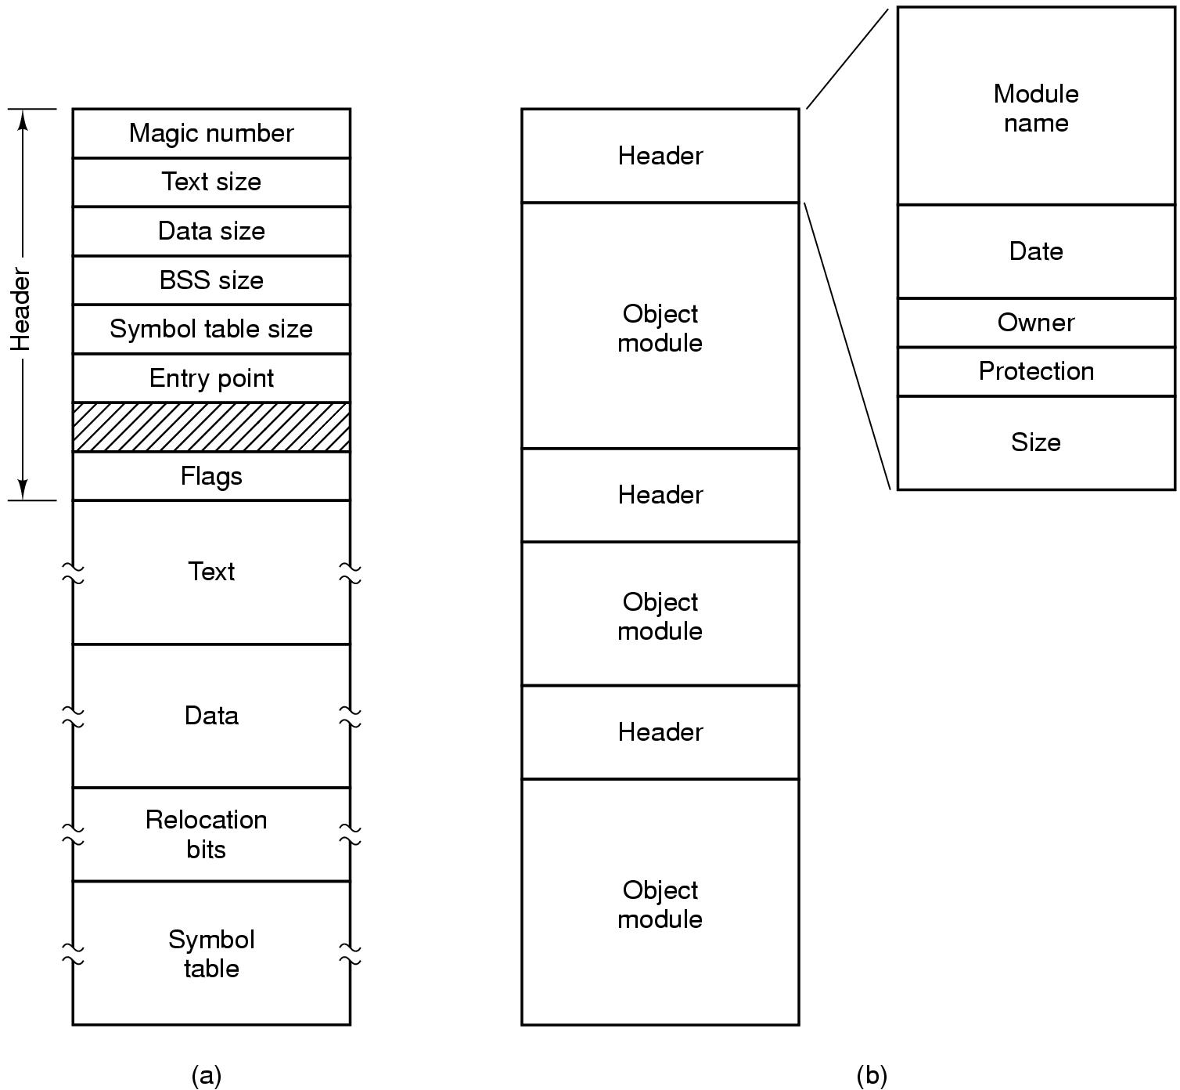
File Types
(a) An executable file (b) An archive

Slide 12
File Access
Sequential access
  read all bytes/records from the beginning
  cannot jump around, could rewind or back up
  convenient when medium was mag tape
Random access
  bytes/records read in any order
  essential for data base systems
  read can be …
    move file marker (seek), then read or …
    read and then move file marker

Slide 13
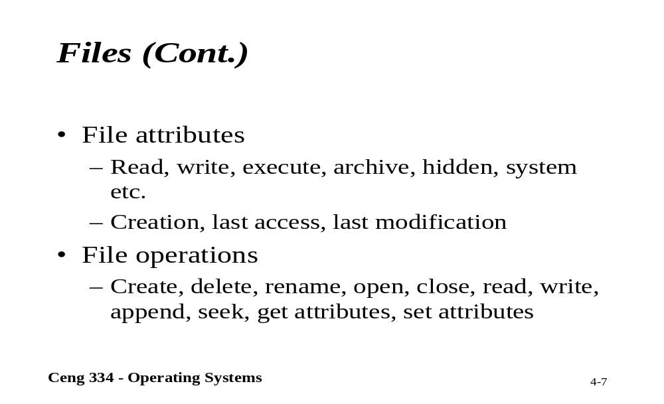
Files

Slide 14
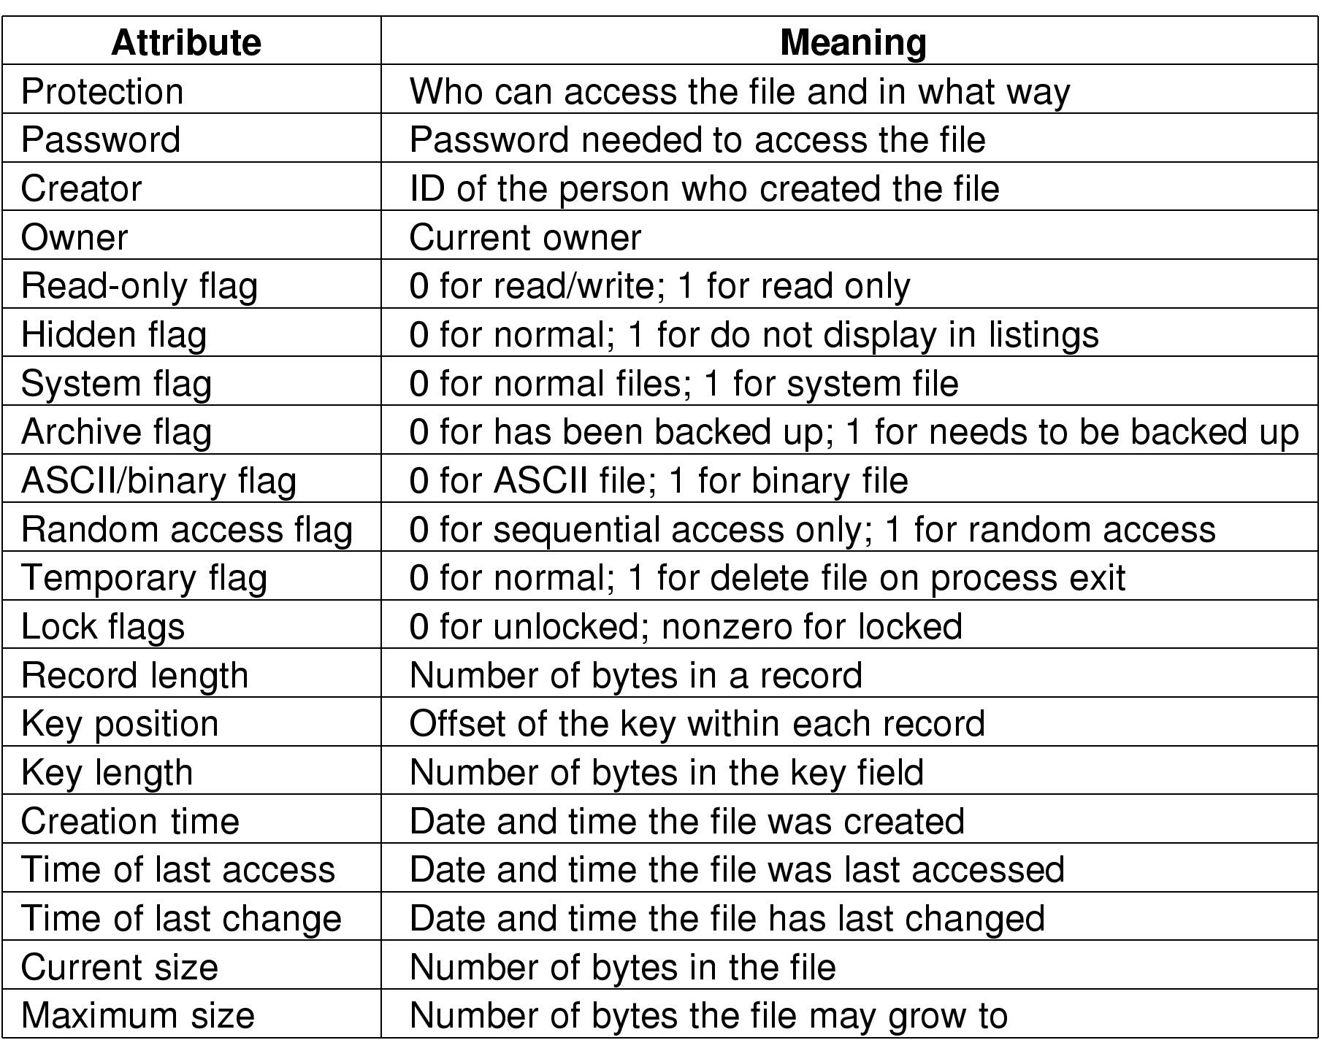
File Attributes
Possible file attributes

Slide 15
File Operations
  Create
  Delete
  Open
  Close
  Read
  Write
  Append
  Seek
  Get attributes
  Set Attributes
  Rename

Slide 16
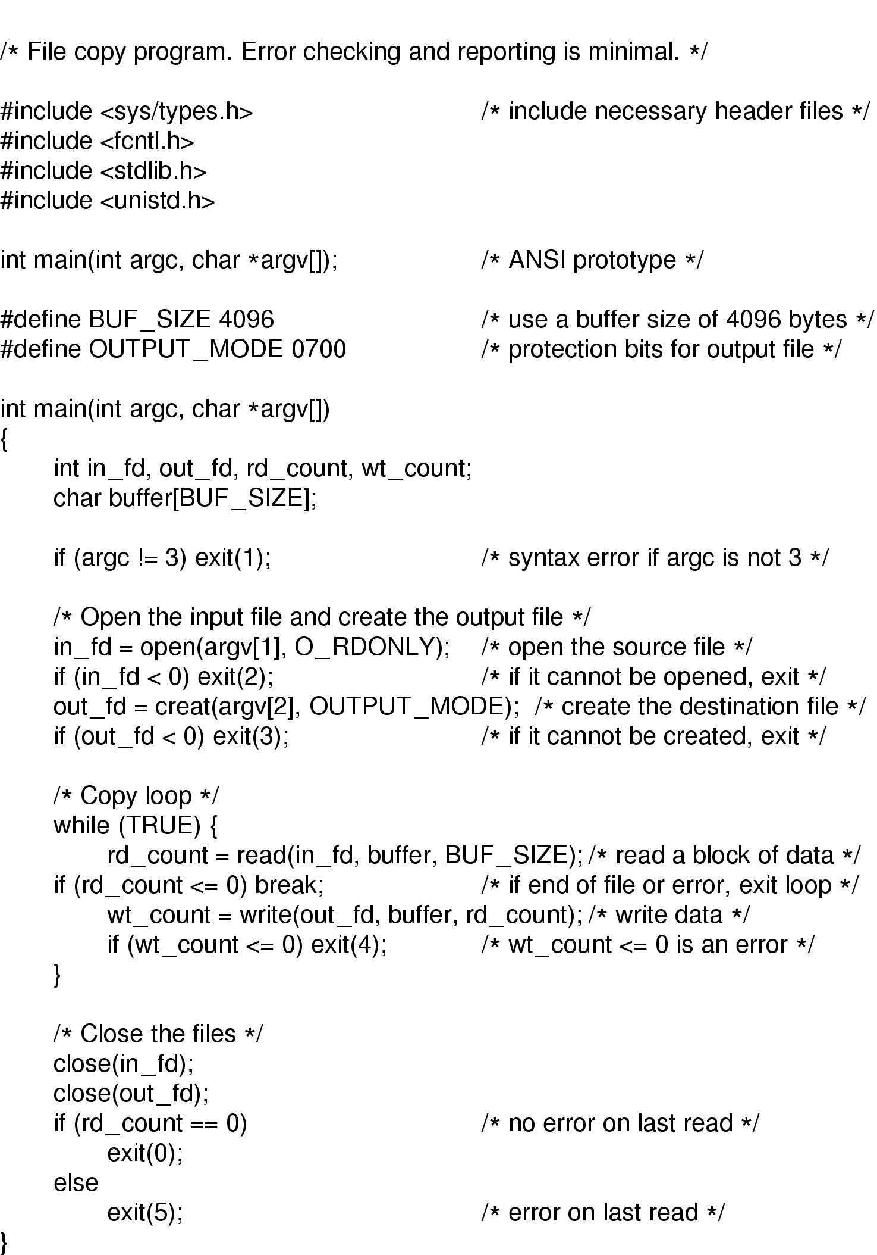
An Example Program Using File System Calls (1/2)

Slide 17
An Example Program Using File System Calls (2/2)

Slide 18
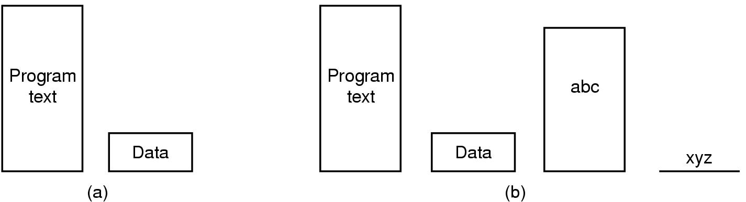
Memory-Mapped Files
(a) Segmented process before mapping files into its address space
(b) Process after mapping
  existing file abc into one segment
  creating new segment for xyz

Slide 19
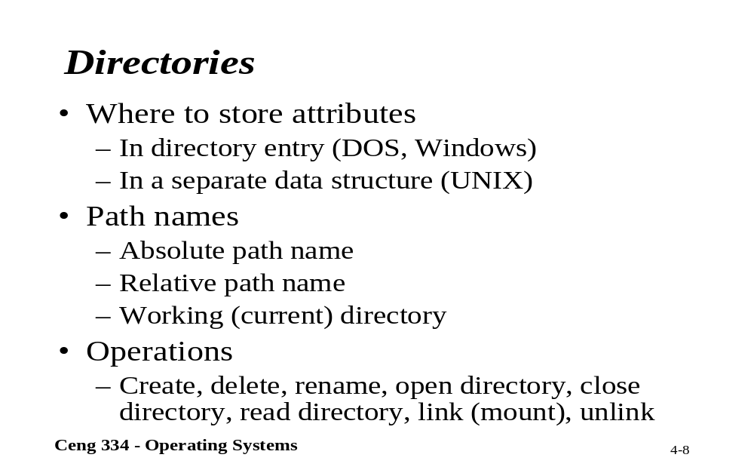
Directories

Slide 20
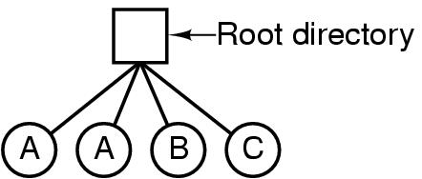
Directories
Single-Level Directory Systems
A single level directory system
  contains 4 files
  owned by 3 different people, A, B, and C

Slide 21
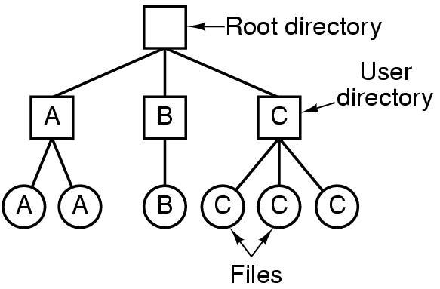
Two-level Directory Systems
Letters indicate owners of the directories and files

Slide 22
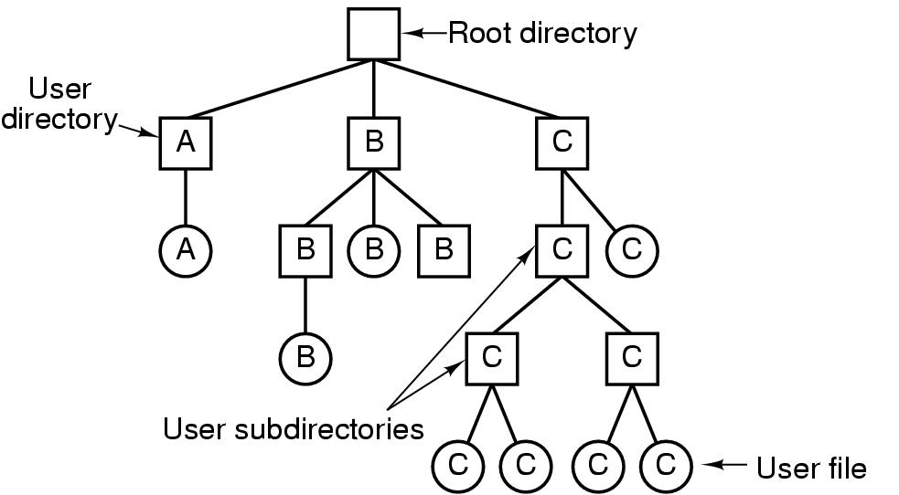
Hierarchical Directory Systems
A hierarchical directory system

Slide 23
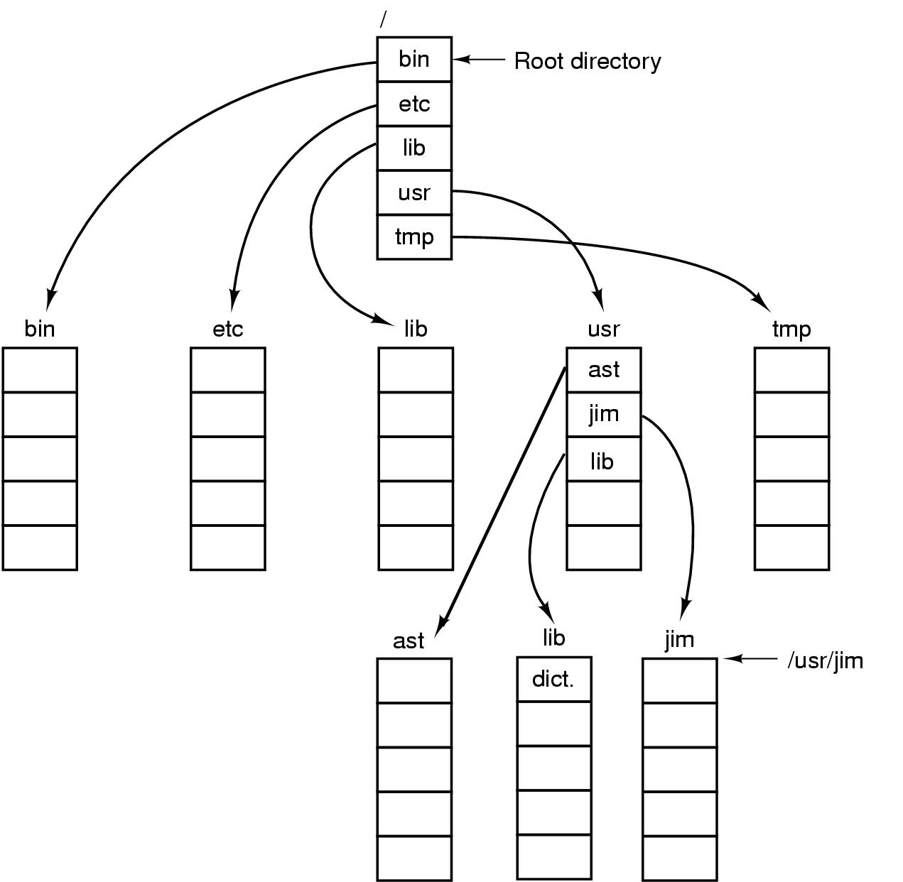
Path Names
A UNIX directory tree

Slide 24
Directory Operations
Create
Delete
Opendir
Closedir
Readdir
Rename
Link
Unlink

Slide 25
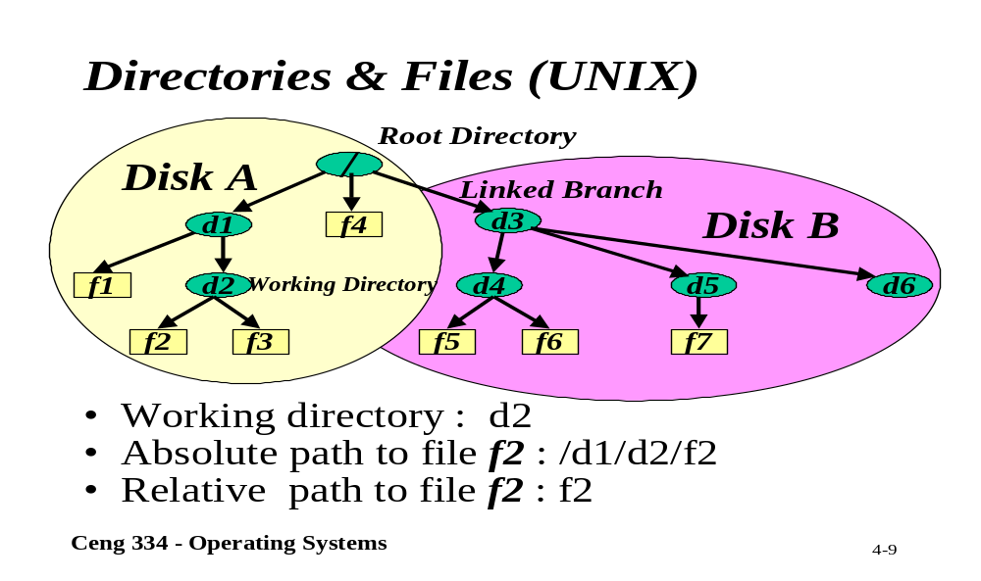
Unix; Directory and Files

Slide 26
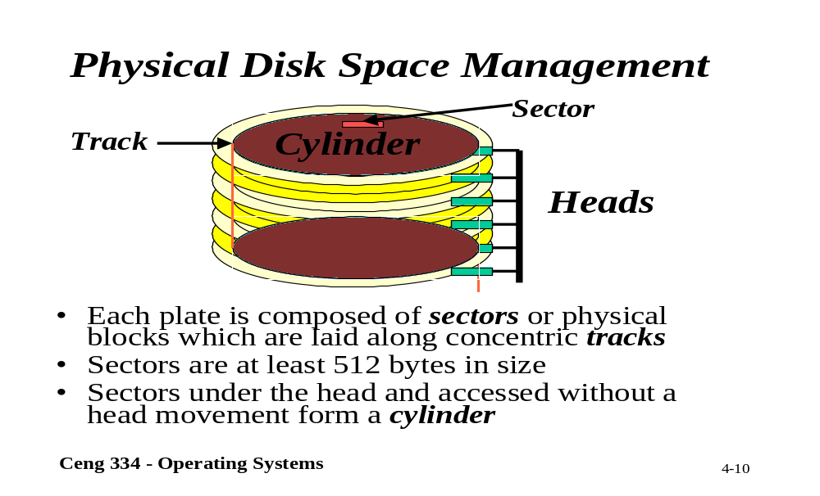
Physical Disk Space Management

Slide 27
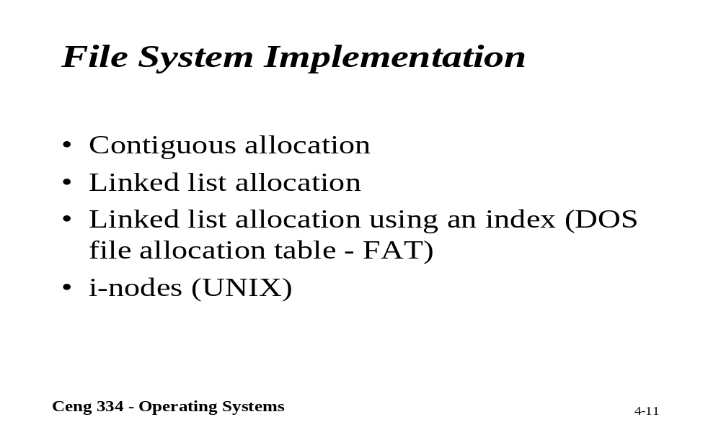
File System Implementation

Slide 28
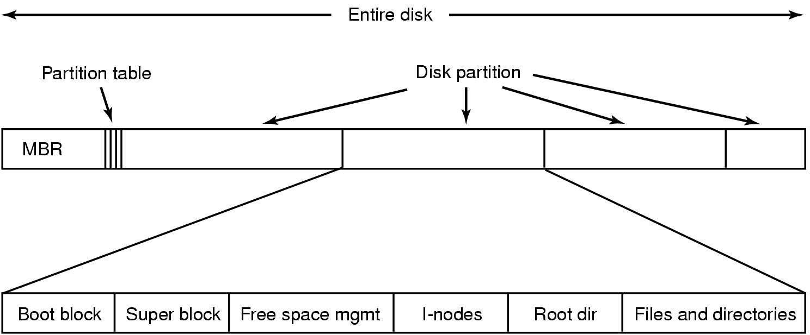
File System Implementation
A possible file system layout
MBR: Master Boot Records is used to boot computer. The end of the MBR contains the partition table. (read boot block and execute)

Slide 29
File System Implementation (2)
MBR (Maste Boot Record) is for locating active partition.
When computer is booted, the BIOS reads in and executes The MBR.
The first think the MBR program is to locate active partition, read in its first block, called the Boot Block.
Super Block contains all the key parameters about the file system and read it into memory when computer is booted or file system is first touched.

Slide 30
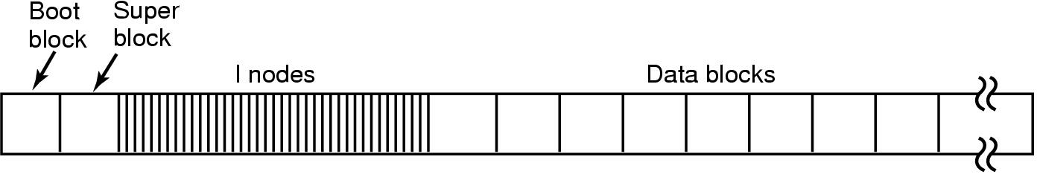
UNIX File System
Disk layout in classical UNIX systems

Slide 31

Implementing Files (3)
(a) Contiguous allocation of disk space for 7 files
(b) State of the disk after files D and E have been removed

Slide 32
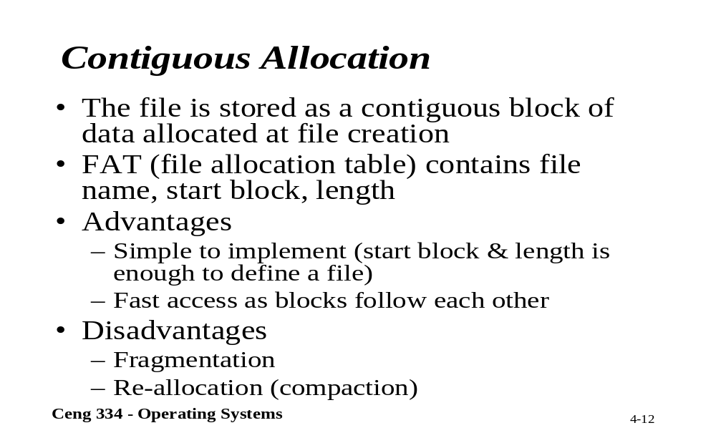
Contiguous Allocation

Slide 33
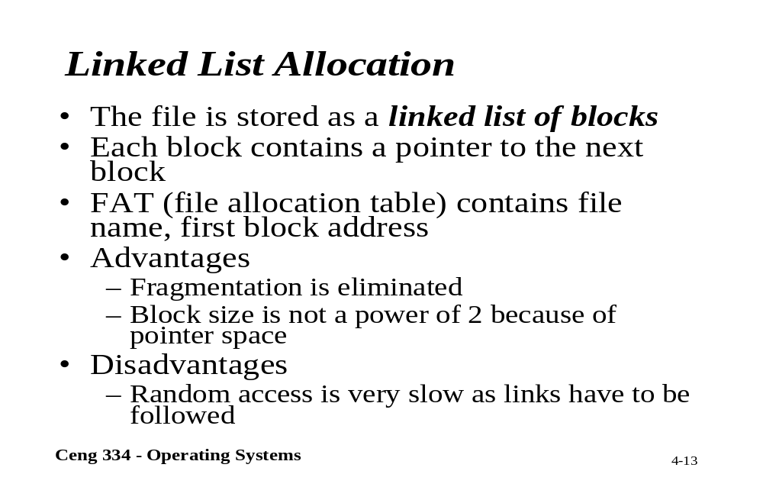
Linked List Allocation

Slide 34

Implementing Files (2)
Storing a file as a linked list of disk blocks

Slide 35
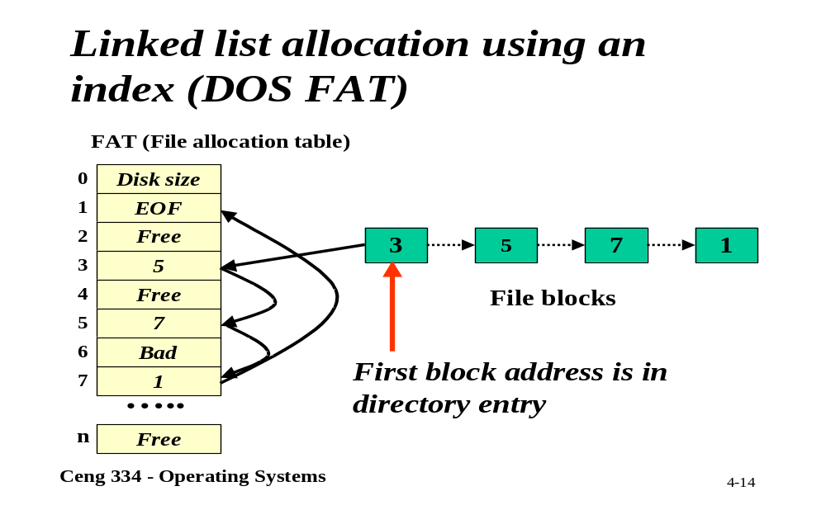
Linked List (DOS FAT)

Slide 36
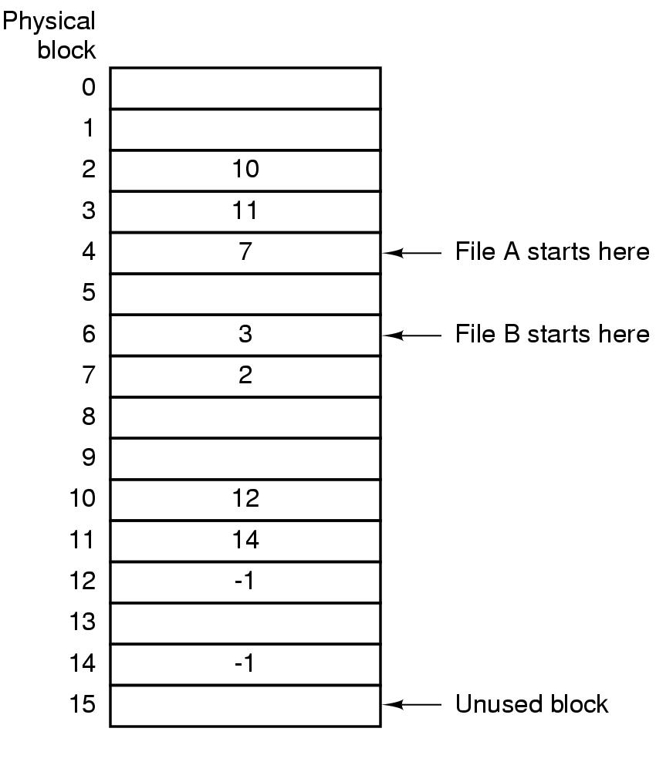
Implementing Files (3)
Linked list allocation using a file allocation table in RAM

Slide 37
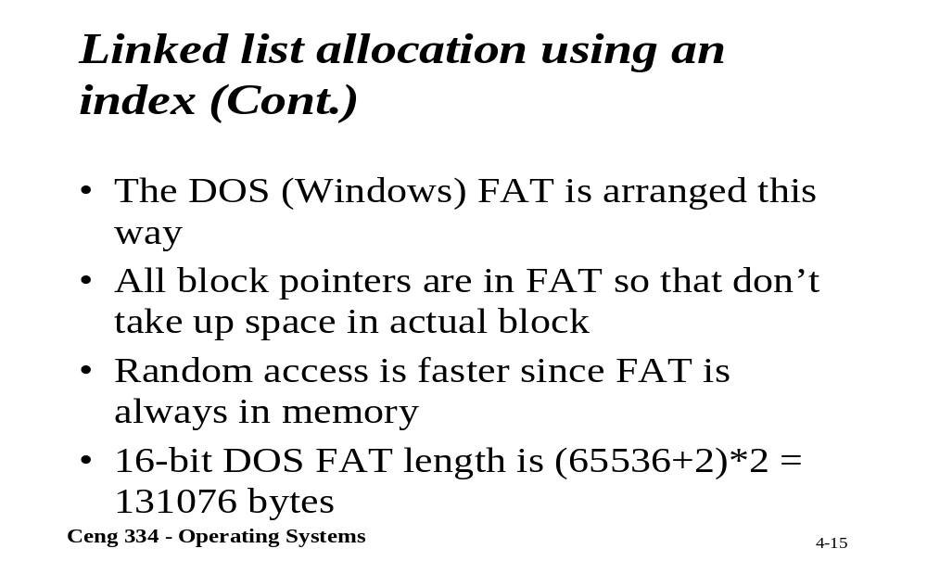
Linked List Using an Index

Slide 38
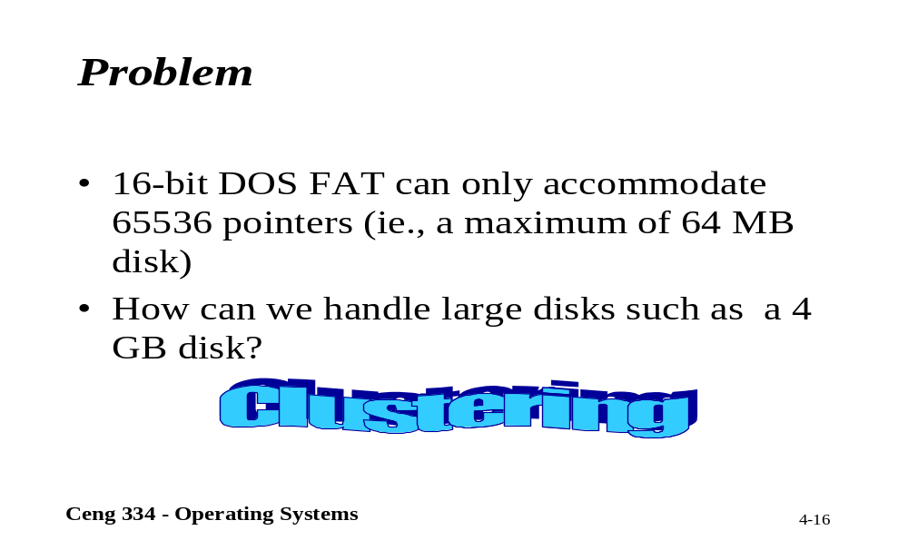
Problems

Slide 39
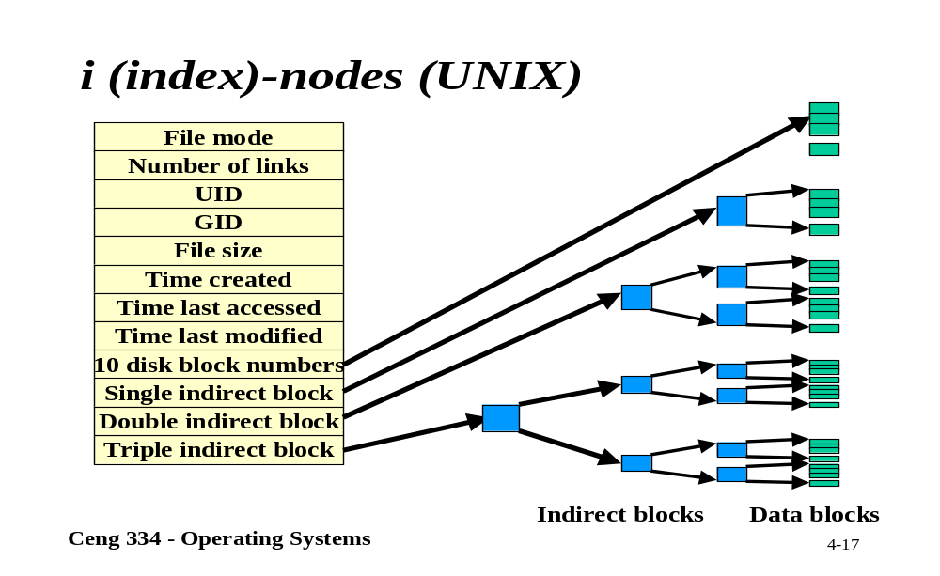
Unix; i-nodes

Slide 40
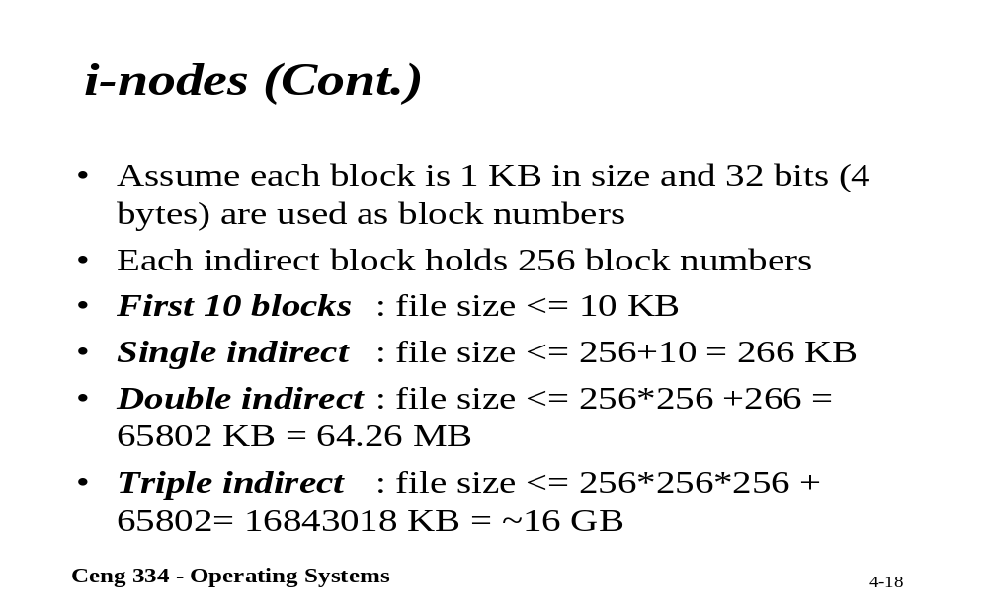
i-nodes

Slide 41
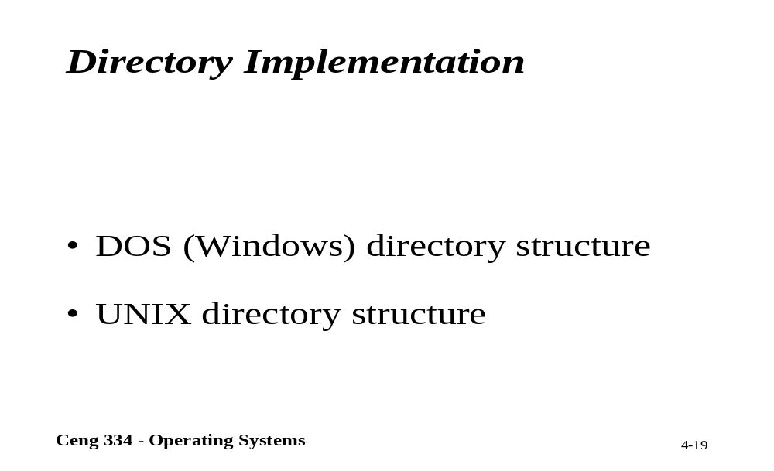
Directory Implementation

Slide 42
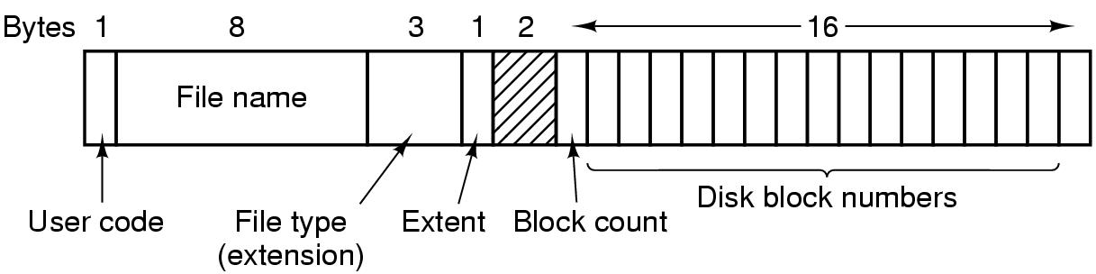
The CP/M File System (2)
The CP/M directory entry format

Slide 43
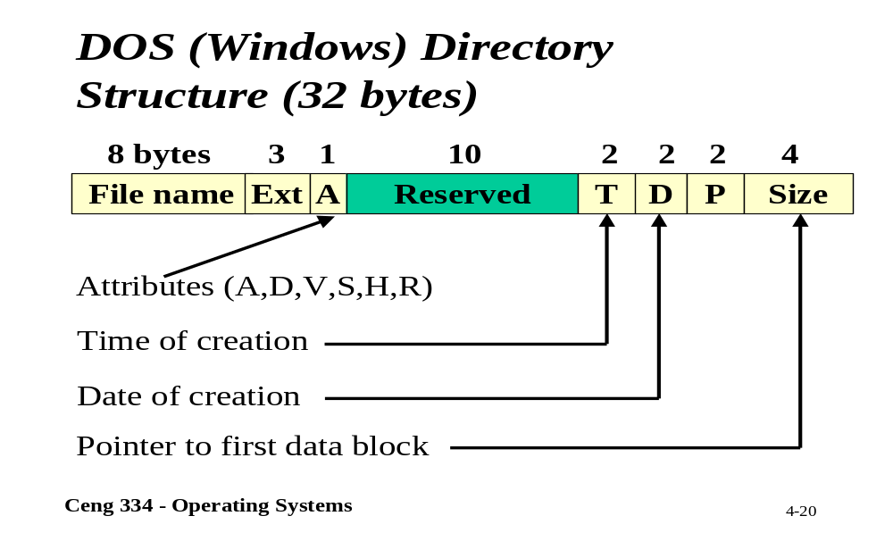
DOS; Directory Structure

Slide 44
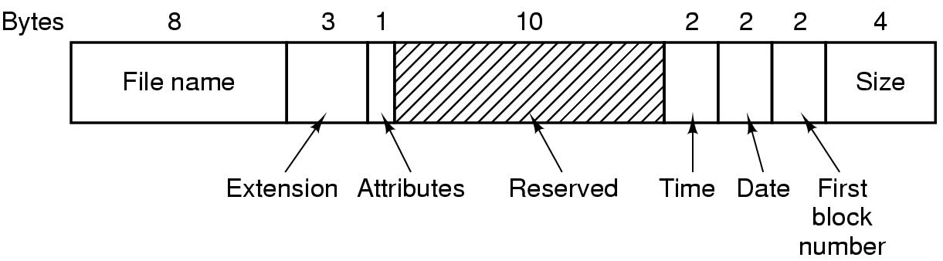
The MS-DOS File System (1)
The MS-DOS directory entry

Slide 45
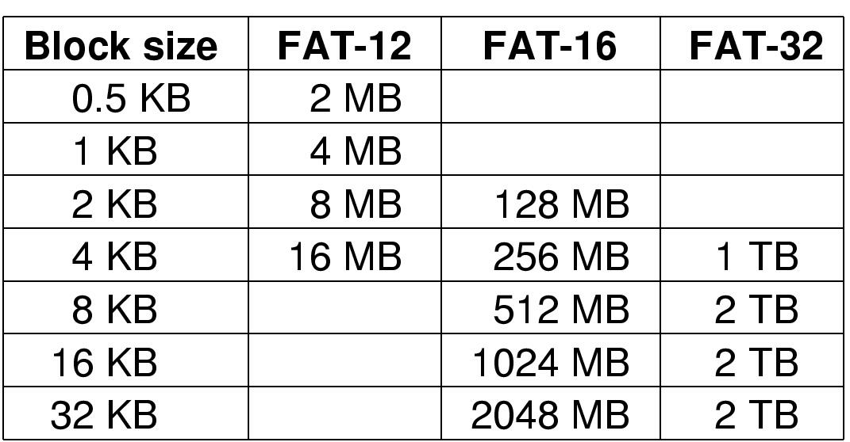
The MS-DOS File System (2)
Maximum partition for different block sizes
The empty boxes represent forbidden combinations

Slide 46
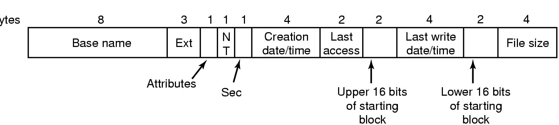
Windows 98: Directory Structure N.
DOS directory entry used in Windows 98
Sec: second,
NT: büyük küçük harf ayrımı ve Windows NT içindir.

Slide 47
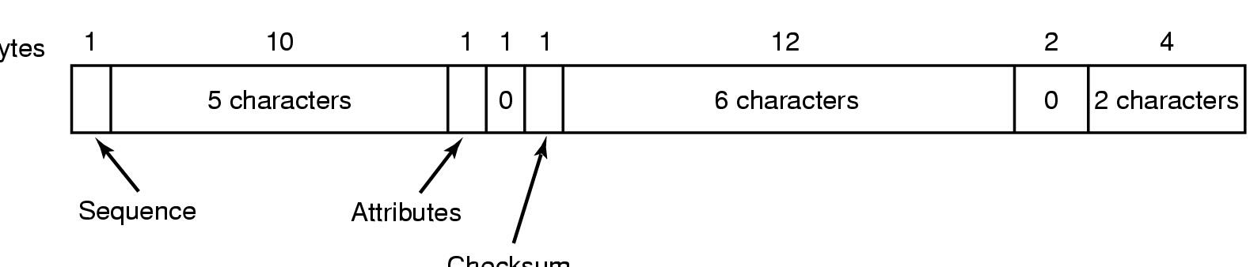
Windows 98: Directory Structure Ext.
An entry for (part of) a long file name in Windows 98.
If attribute is 0x0F, the MS-DOS ignores the entry as invalid.

Slide 48
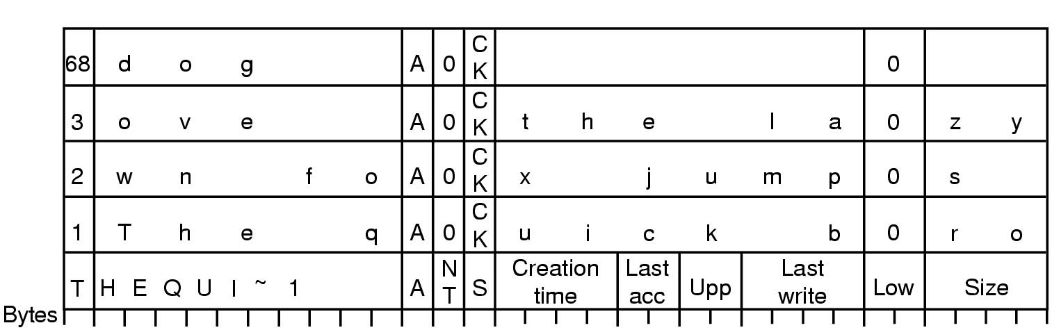
An example of how a long name is stored in Windows 98
6 bit are used for the sequence number and 63013 819 character (long file name are possible).
Because of historic reasons this limited to 260 characters. (last sequence number 68 = 64 + 4 seq. of previous row)
The quick brown fox jumps over the lazy dog.
6 bit =64+4 =68, en uzun at teorik >13*64 819 checksum’dan dolayı 260 dır.

Slide 49
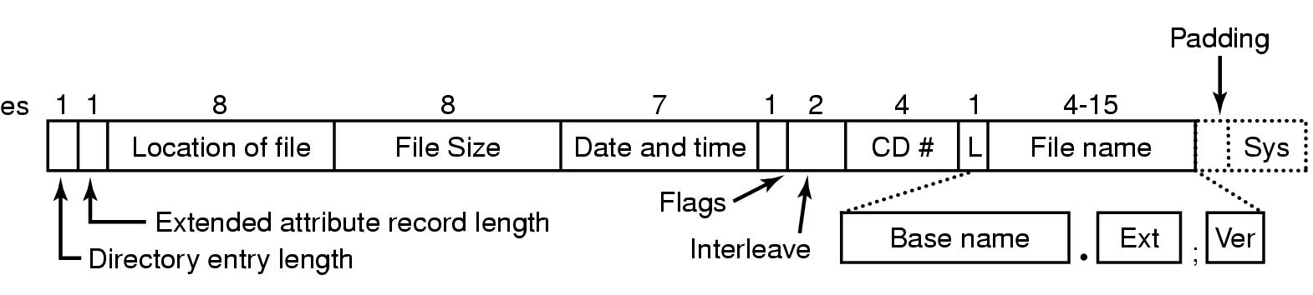
Example File Systems
CD-ROM File Systems
The ISO 9660 directory entry

Slide 50
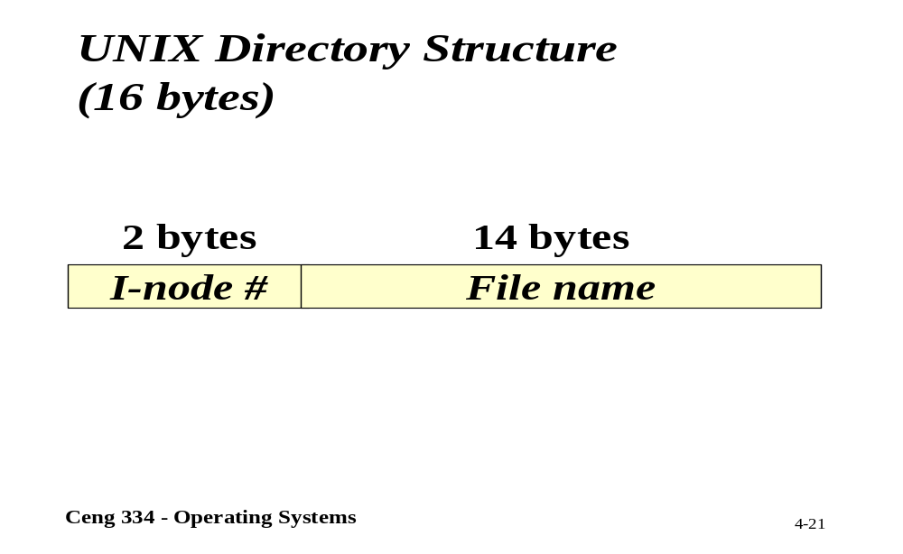
Unix; Directory Structure

Slide 51
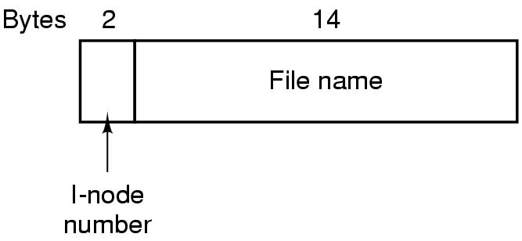
The UNIX V7 File System (1)
A UNIX V7 directory entry

Slide 52
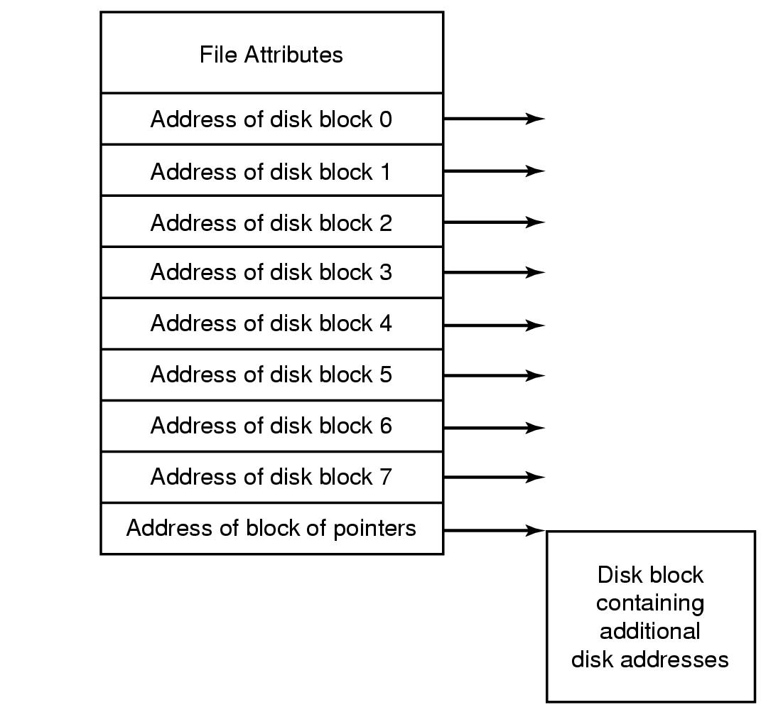
Implementing Files (4)
An example i-node

Slide 53
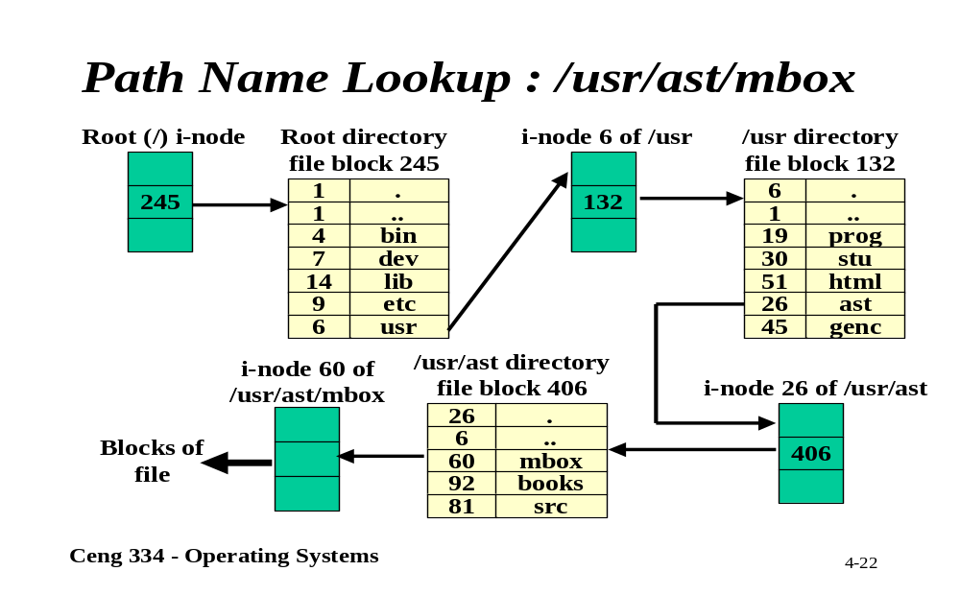
Path Name Lookup

Slide 54
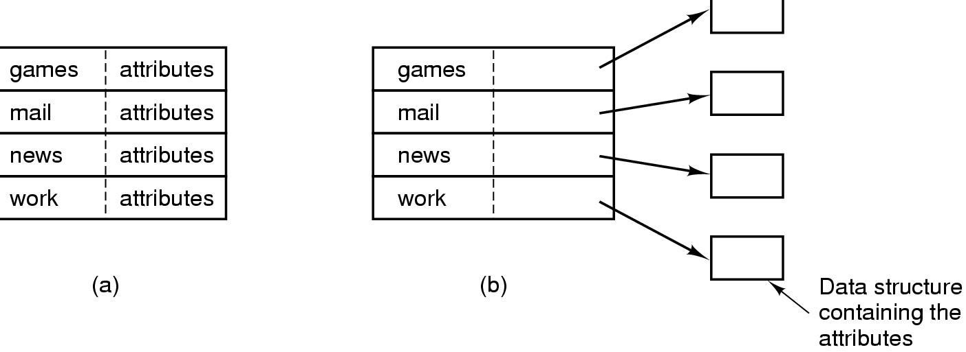
Implementing Directories (1)
(a) A simple directory
  fixed size entries
  disk addresses and attributes in directory entry
(b) Directory in which each entry just refers to an i-node

Slide 55
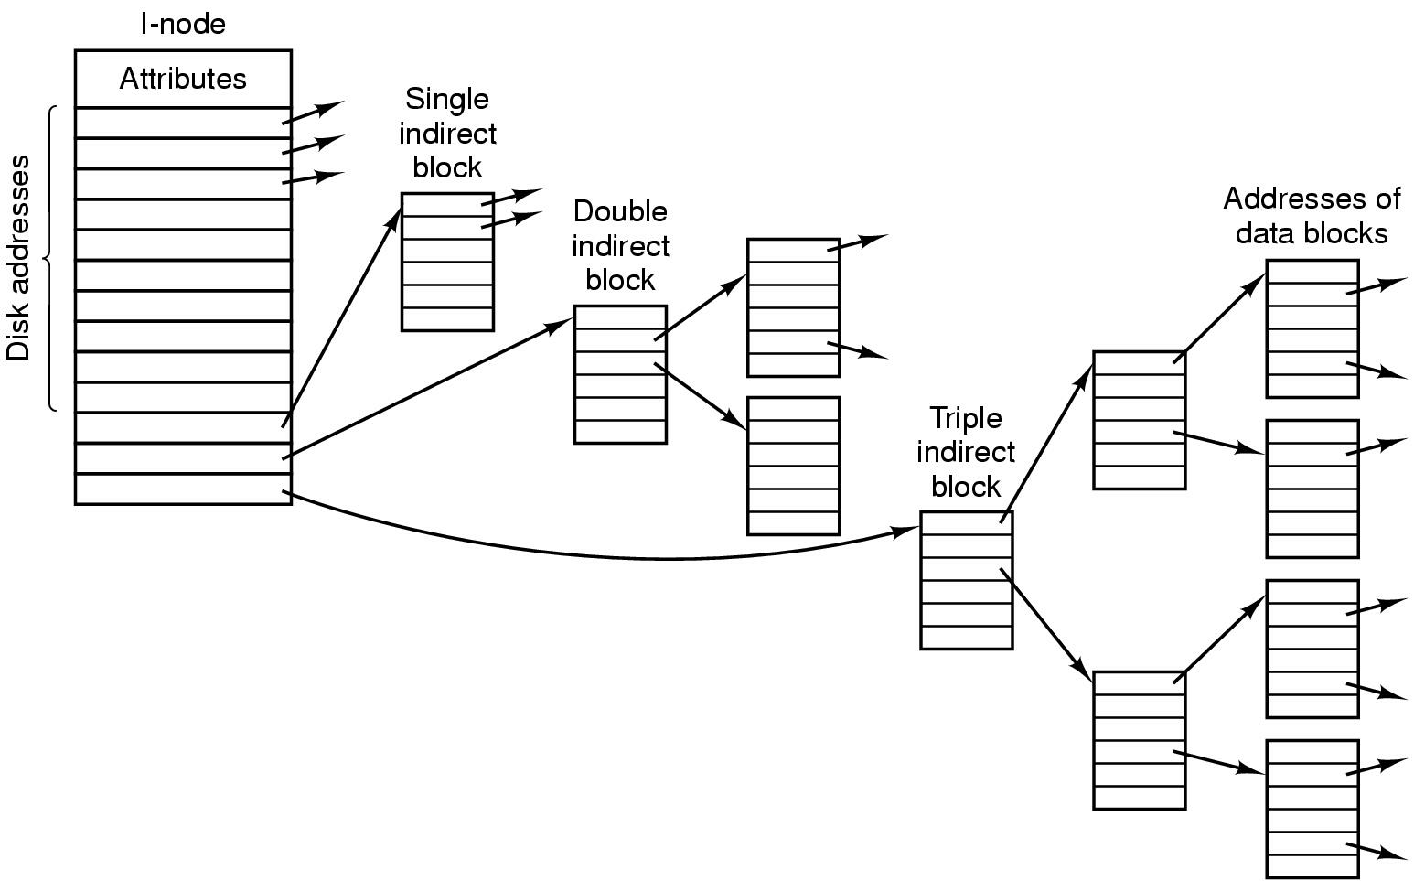
The UNIX V7 File System (2)
A UNIX i-node

Slide 56
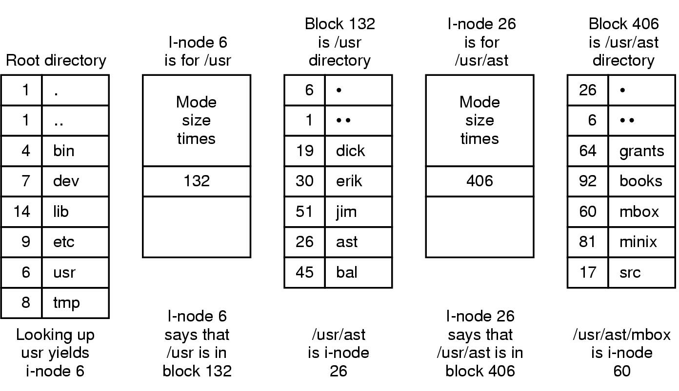
The UNIX V7 File System (3)
The steps in looking up /usr/ast/mbox

Slide 57
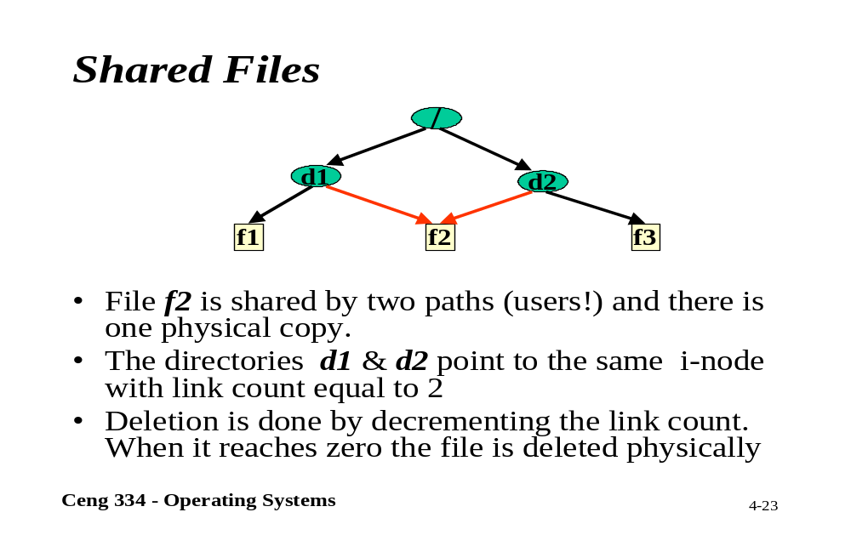
Shared Files

Slide 58
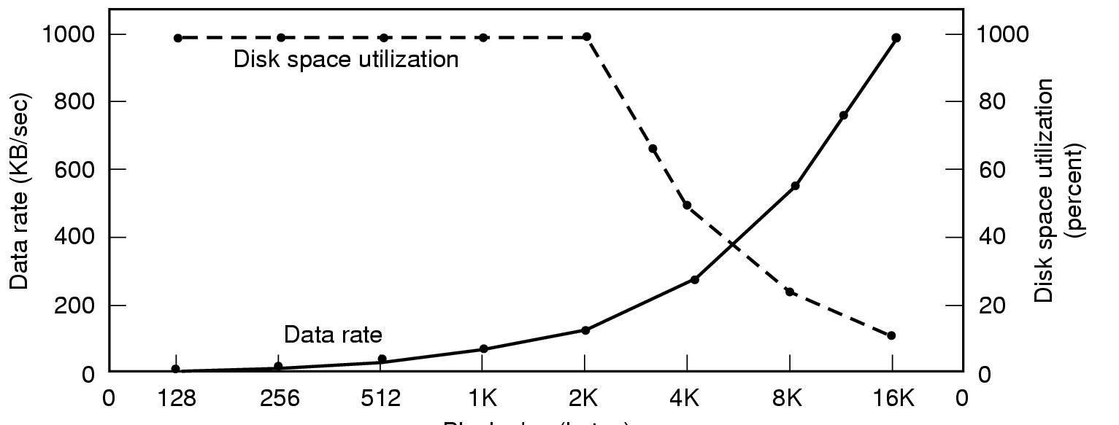
Disk Space Management
Dark line (left hand scale) gives data rate of a disk
Dotted line (right hand scale) gives disk space efficiency
All files 2KB

Slide 59
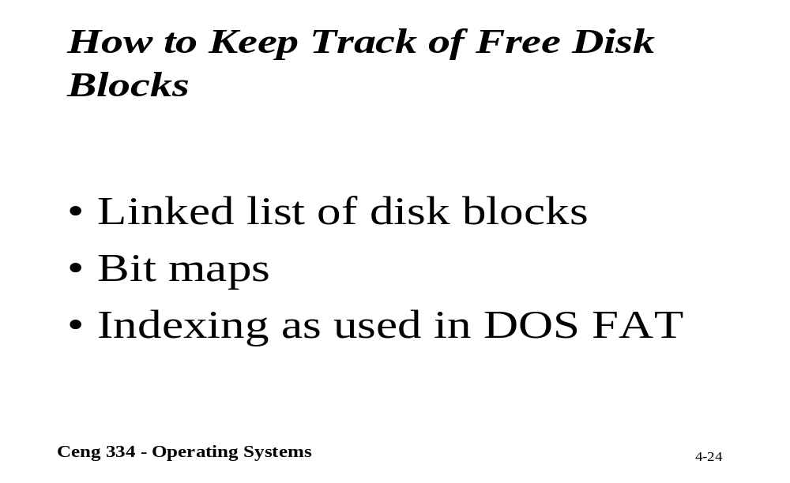
Keeping Track of Disk Blocks

Slide 60
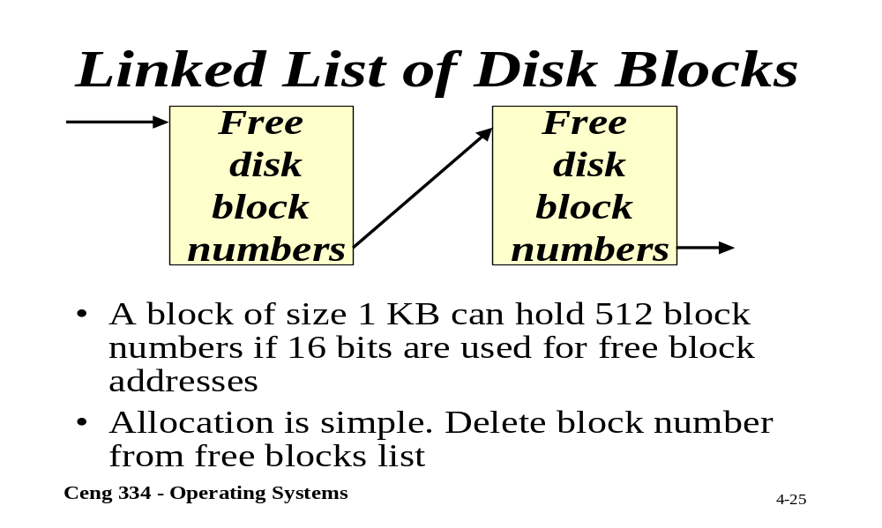
Linked List of Disk Blocks

Slide 61

Bit Maps

Slide 62

Disk Space Management (2)
(a) Storing the free list on a linked list
(b) A bit map

Slide 63

File System Reliability
File system states
  (a) consistent
  (b) missing block
  (c) duplicate block in free list
  (d) duplicate data block

Slide 64

File System Performance

Slide 65

File Position

Slide 66

File Position in i-node

Slide 67

File Position in Process Table

Slide 68

Solution

Slide 69

Shared Files (1)
File system containing a shared file

Slide 70

Shared Files (2)
(a) Situation prior to linking
(b) After the link is created
(c)After the original owner removes the file

Slide 71

File System Performance (2)
I-nodes placed at the start of the disk
Disk divided into cylinder groups
  each with its own blocks and i-nodes

